Slide 1

KALERWE
Church Hymnal 395
3 ~ Verses
13.
Yesu Wasuubiza…
~
Jesus Thou Hast Promised…

Slide 2


1 of 3 verses
Yesu wasuubiza ffe abantu bo
Bwetubeer(a) awamu,
oba kumpi nnyo;
Kigambo- kakano tukikkiriza,
Beera naffe wano otusanyuse.

Slide 3
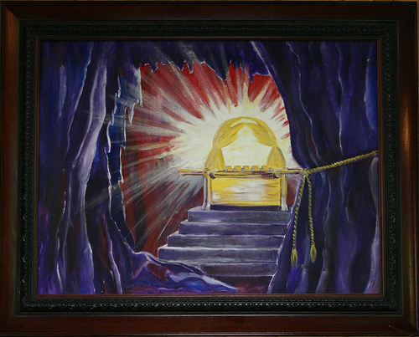
1 of 3 verses
CHORUS:
Yesu jj-angu mu ffe,
Nga tuli- wano;
(O)mukisa- gwo gu- -bee
mu kuku’ngana

Slide 4
2 of 3 verses
Bulijjo Mukama obadde naffe, Yonger(a) okubeera awamu wano; Gwe totu-vangako, tukwetaaga nnyo, Ayi Yesu jjangu tukulabeko.

Slide 5
2 of 3 verses
CHORUS:
Yesu jj-angu mu ffe,
Nga tuli- wano;
(O)mukisa- gwo gu- -bee
mu kuku’ngana

Slide 6
3 of 3 verses
Yesu otuyambe
ffe nga tuyimba,
(E)nnyimba zaffe zonna zikusanyuse.
(E)Ssuubi lya-ffe mu ggwe lyeyongerenga,
Naffe tweyonger(e)
okukufaanana

Slide 7
3 of 3 verses
CHORUS:
Yesu jj-angu mu ffe,
Nga tuli- wano;
(O)mukisa- gwo gu- -bee
mu kuku’ngana

